Slide 1
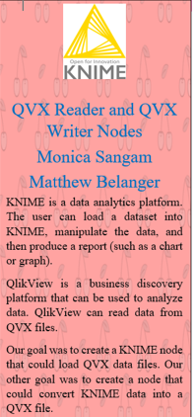
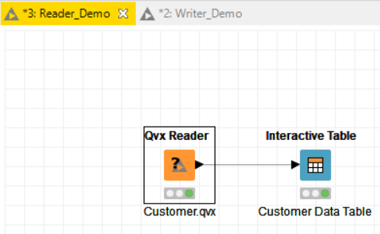
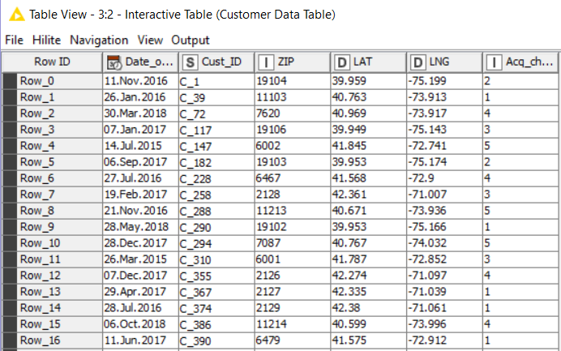
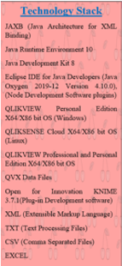
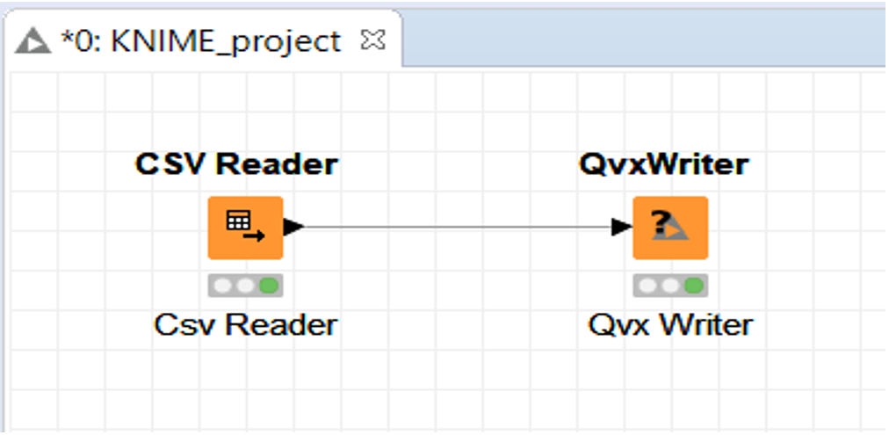
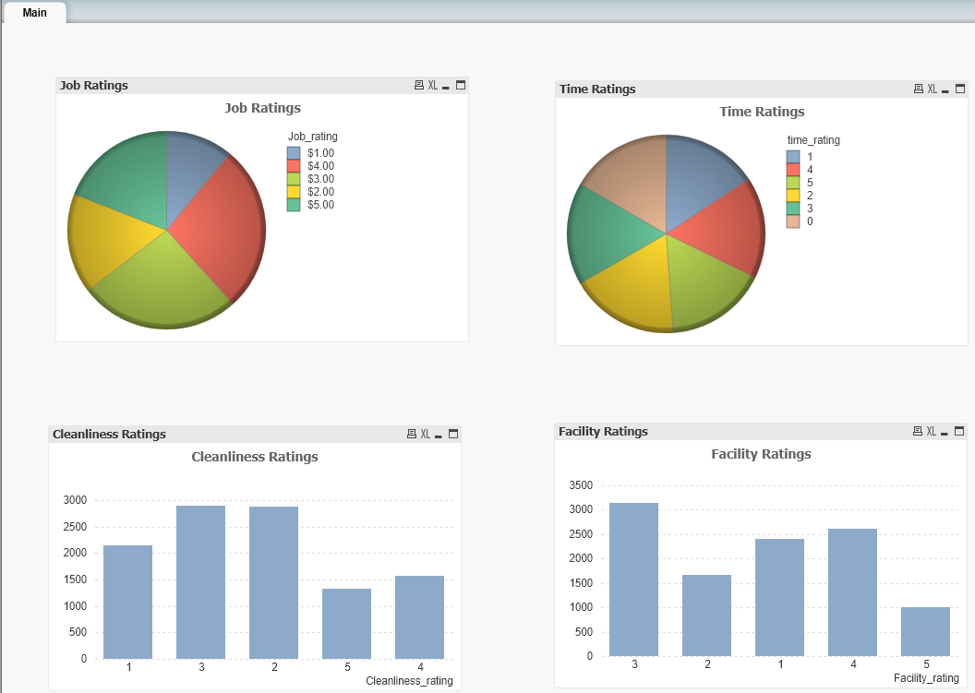
Qvx Reader workflow; a Qvx file is read and then loaded into a KNIME data table.
In KNIME, we can view the table created by the Qvx Reader.
Qvx Writer workflow; a Qvx file is generated from a csv file.
In QlikView, we can load this qvx file in order to create a data visualization.

